Slide 1



Aeon
Lab Manual Assistant Agent
Students: Likith Raj H, P. Sai Srinand Nihal, K. Datta Sai Reddy | Batch: 2027
Duration: 2 Months | Tech: LangChain AI Agents

Slide 2


PROJECT OVERVIEW
Mission Statement
This project aims to build an AI-powered assistant that helps students and learners interactively query and understand laboratory manuals using natural language. By leveraging Retreival – Augmented Generation (RAG), the system provides accurate, context – aware answers directly from uploaded lab PDFs
Example: Our agent enables students to query lab manual PDFs using natural language by combining LangChain – based RAG, FAISS vector search and a locally hosted LLM
▪
Core Focus: Education Industry
▪
Main LangChain Module: RetrievalQA (RAG Pipeline)

Slide 3
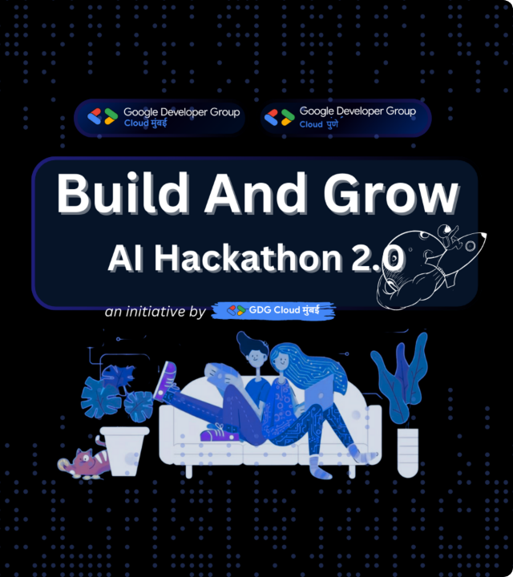


THE CHALLENGE
Identifying the Friction
Students struggle to quickly find relevant information in lengthy lab manuals. Manual searching or keyword - scripts are slow and fail to understand context or intent
Lab manual PDFs are time-consuming to navigate, and basic search tools cannot answer contextual or follow-up questions, creating the need for an AI-based solution.

Slide 4




TECHNOLOGY STACK
Framework
LLM Engine
Vector DB
Hosting
RAG Framework: LangChain
LLM: Ollama (phi3:mini)
Vector DB: FAISS(Facebook AI Similarity Search)
Hosting / Frontend: Streamlit

Slide 5
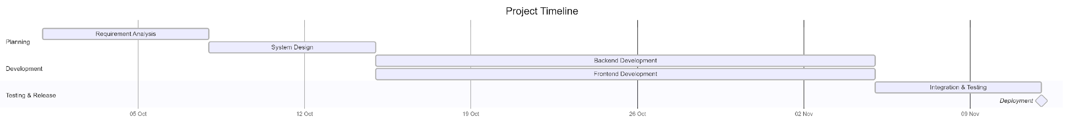
TIMELINE
The project begins with requirement analysis and system design in early October. Backend and frontend development are carried out in parallel from mid-October to early November to optimize time. This is followed by integration and testing, and the project concludes with deployment as the final milestone.

Slide 6
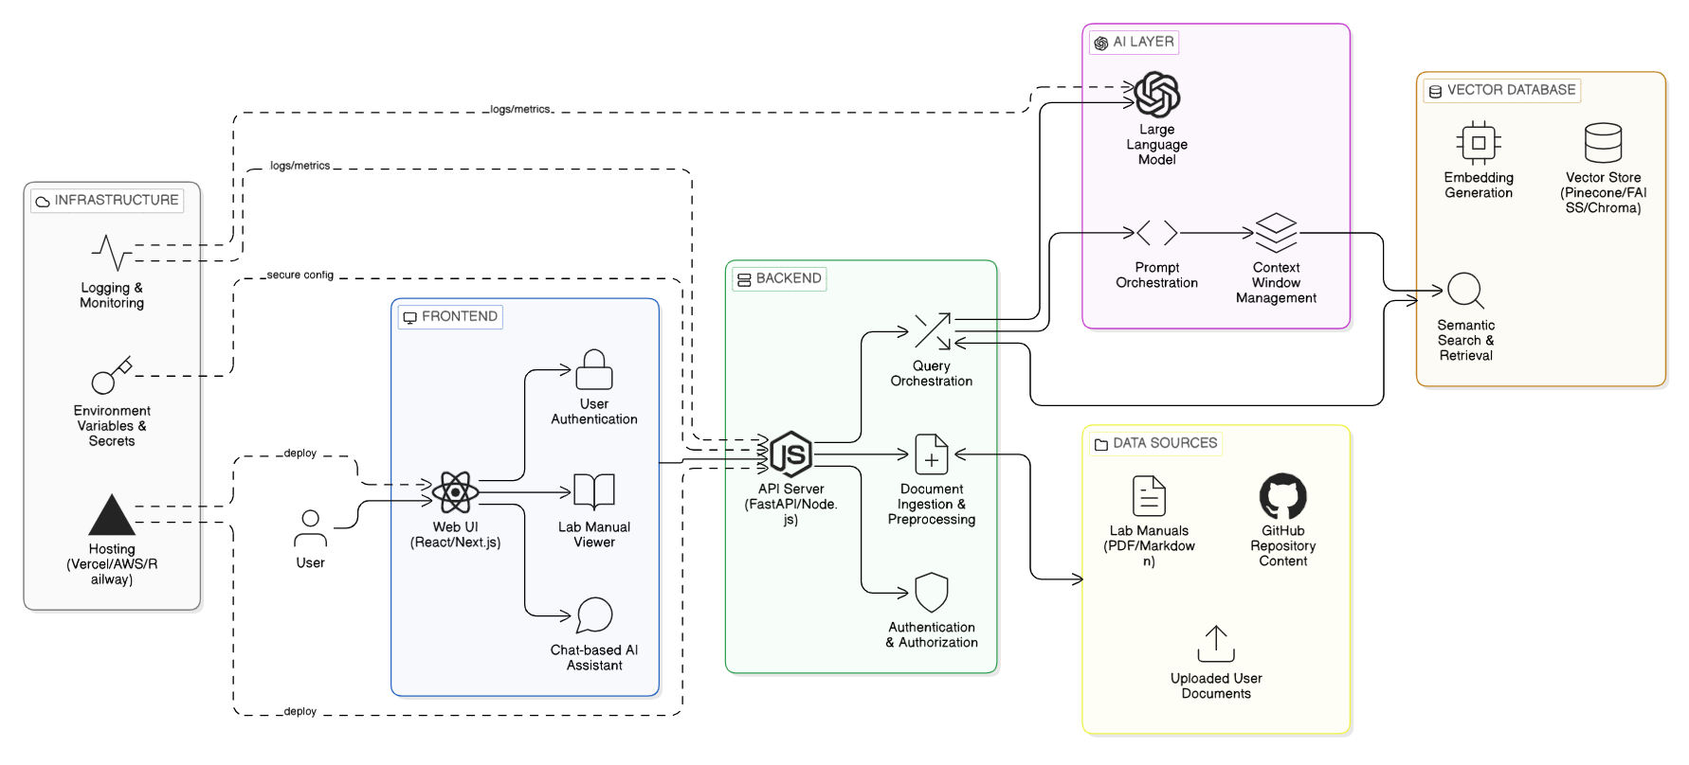

SYSTEM ARCHITECTURE
Technical Workflow
Step 1: Input Processing
PDF + User query.
Step 2: Retrieval/ Tool Logic
FAISS semantic search.
Step 3:
Context evaluation by LLM.
Step 4:
Grounded answer generation.
The agent follows a retrieval-augmented reasoning loop where each query triggers semantic retrieval from the vector database before generating a grounded response using a local LLM.

Slide 7


NOVEL APPROACH
What makes your project stand out?
Context-aware question answering directly from lab manual pdfs
Local LLM execution using Ollama for privacy and low latency
AI-powered lab manual Q&A using RAG
Accurate answers grounded in PDF content
Simple, student-friendly Streamlit interface
Unique

Slide 8
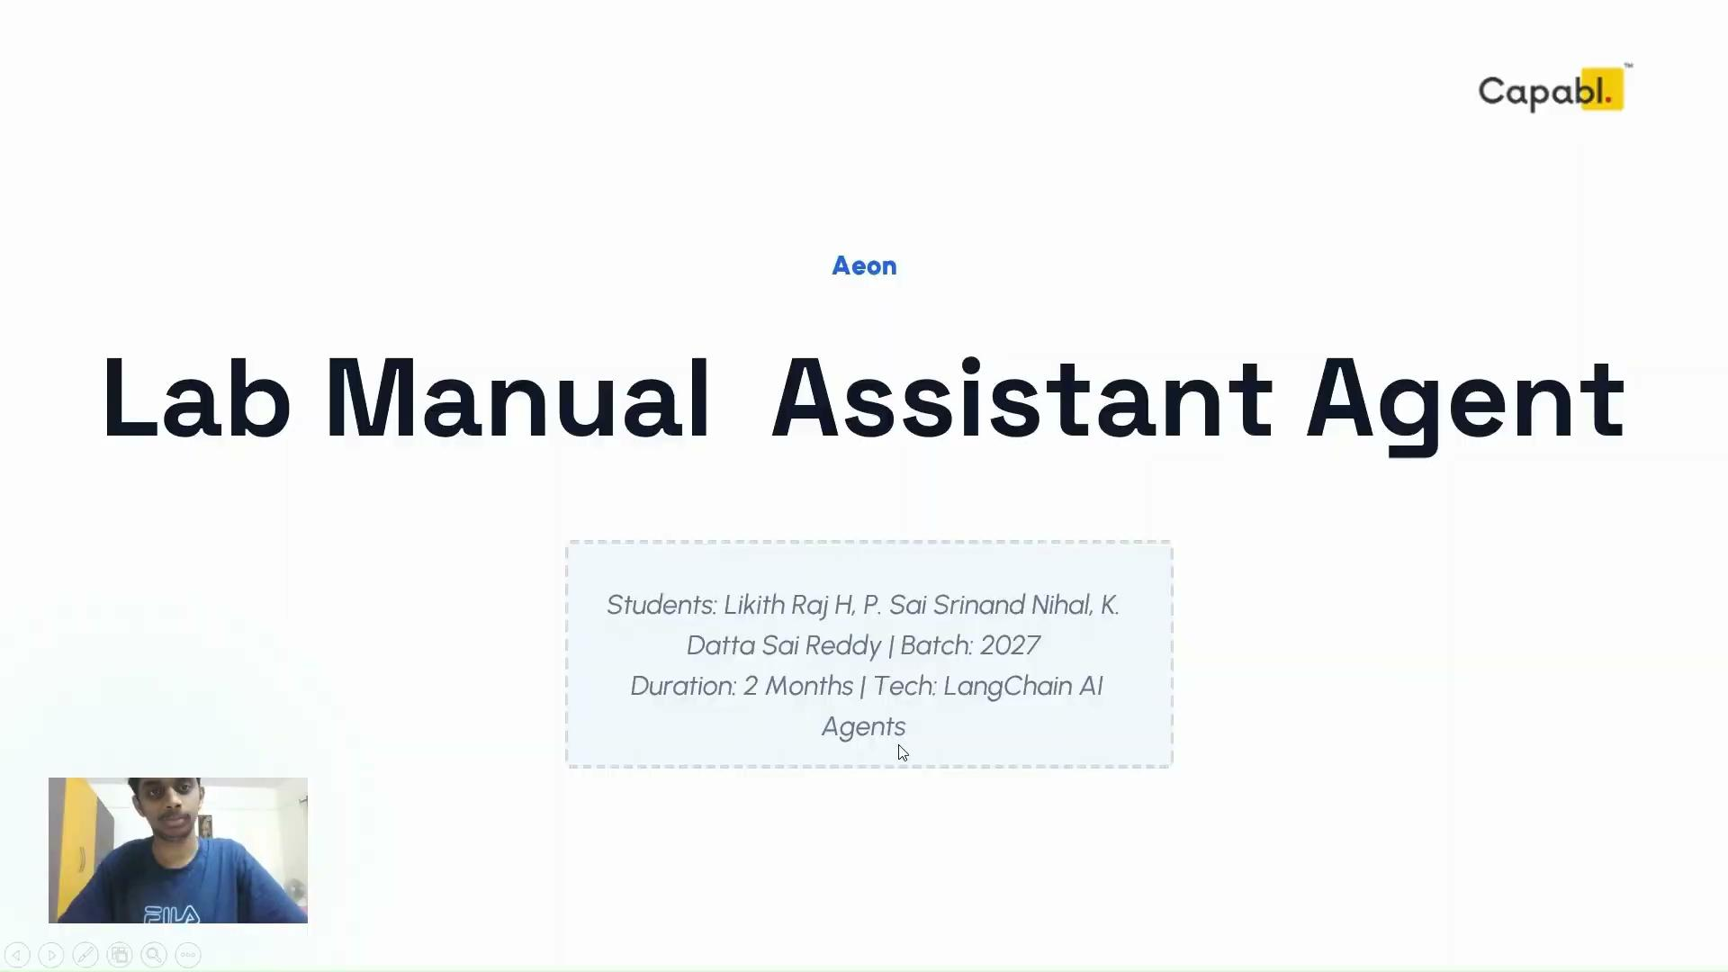
DEMO VIDEO

Slide 9
ROADMAP & FUTURE SCOPE
Phase 1
Phase 2
Phase 3
Multi-PDF support, better grounding
Scalable Storage, multi-user support
Chat UI, Source Highlighting

Slide 10

Conclusion
Ultimately, this project demonstrates how RAG-based AI agent can transform lab manual usage by providing instant, accurate, and context-aware answers in a privacy-first, local setup
THANK YOU FOR YOUR ATTENTION
Questions & Feedback are welcome.

